Slide 1
MY GAME
CAMERON TYREE

Slide 2
What is my game?
My game is a stealth game
3 guards
The main goal is to unveil the secret this facility has been hiding from the world for over 300 years
5 rooms + final room
5 clues
Clues = Riddles
Riddles = Numbers
Numbers = Final Code
With the final code you go to the final room and reveal the secret

Slide 3
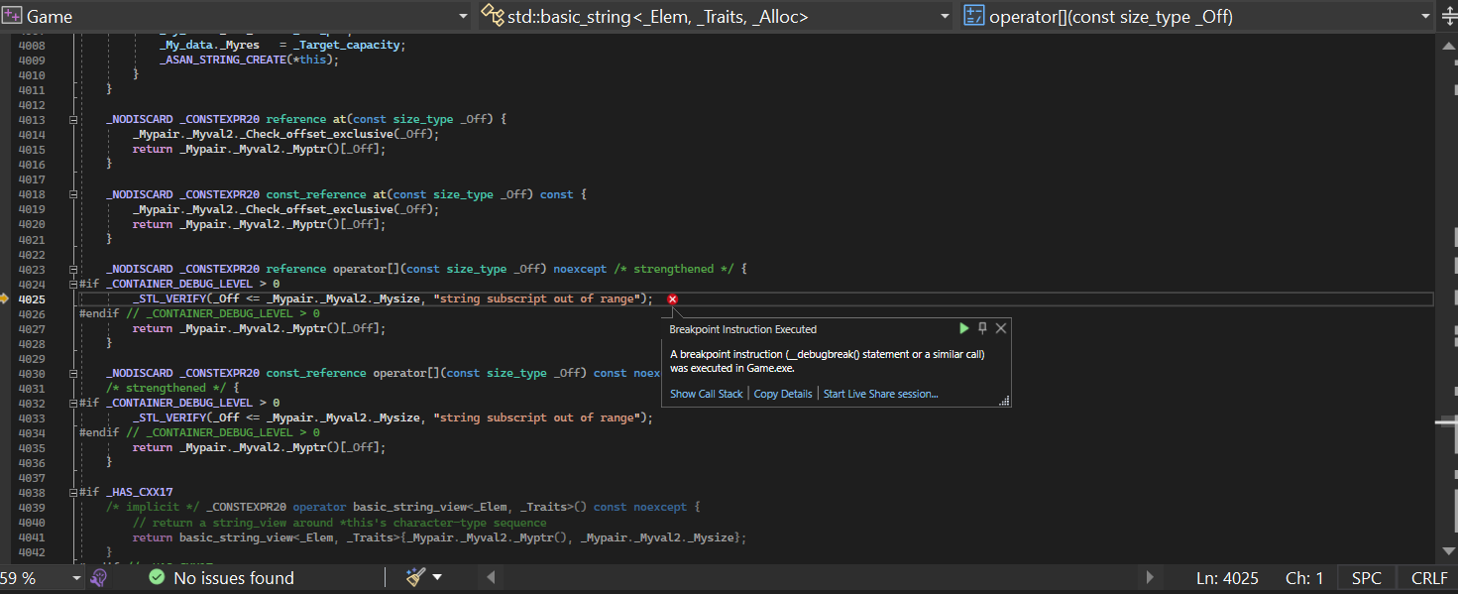
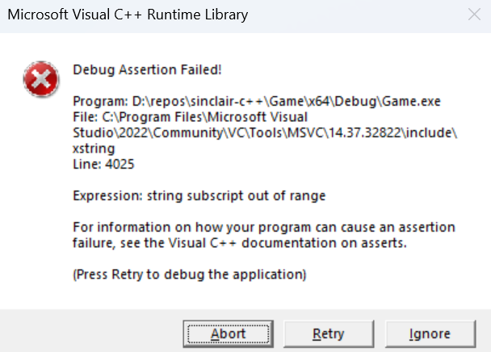
Problems I had

Slide 4
Things I learned
How to handle player movement with wasd
How to build a map using a for loop
What _getch() does
How to draw a maze/walls with 1’s and 0’s

Slide 5
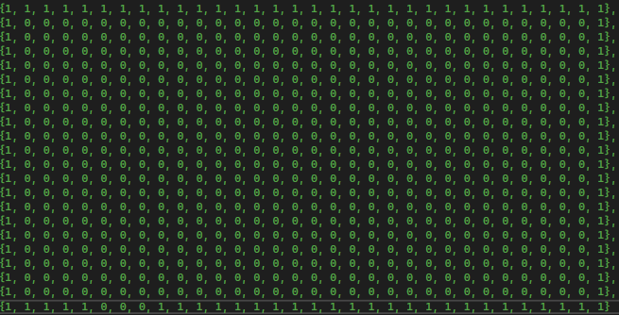
What am I most proud of?
The maze/walls I created with the 1’s and 0’s
I was most proud of this because:
I made it to where the guards and players couldn’t move through the 1’s
It was fun to make

Slide 6
If I had more time what would i do?
I would make it to where:
The guards followed the player instead of just moving randomly
Give the player weapons to execute the guards
If the player executes a guard then the guards would be alerted

Slide 7
Additional information
There is a easter egg in one of the rooms
If you find it, you get candy

